Slide 1
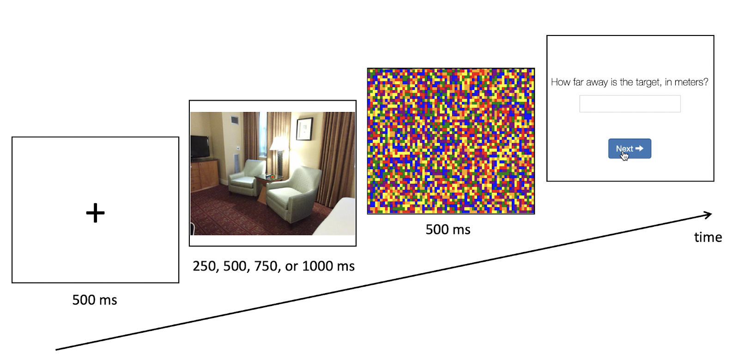
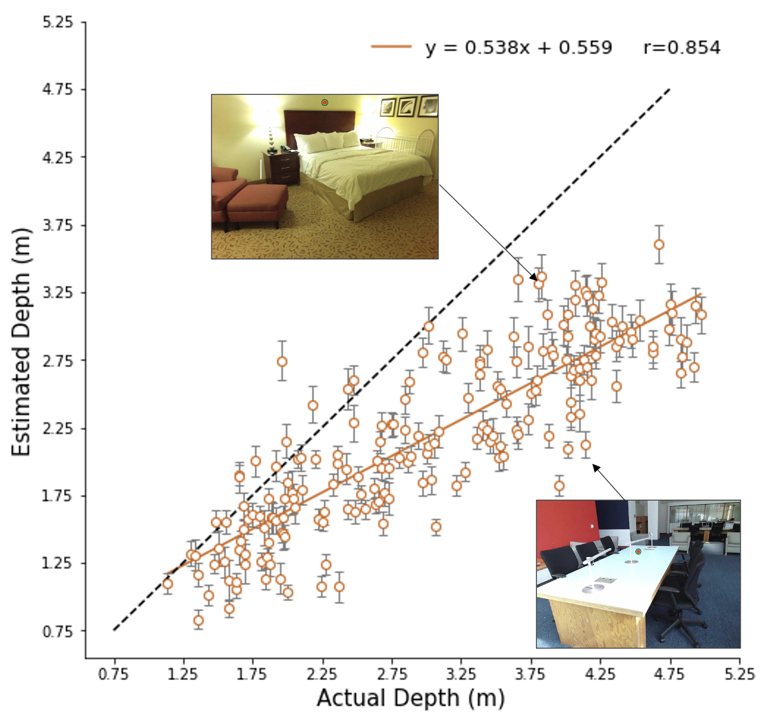
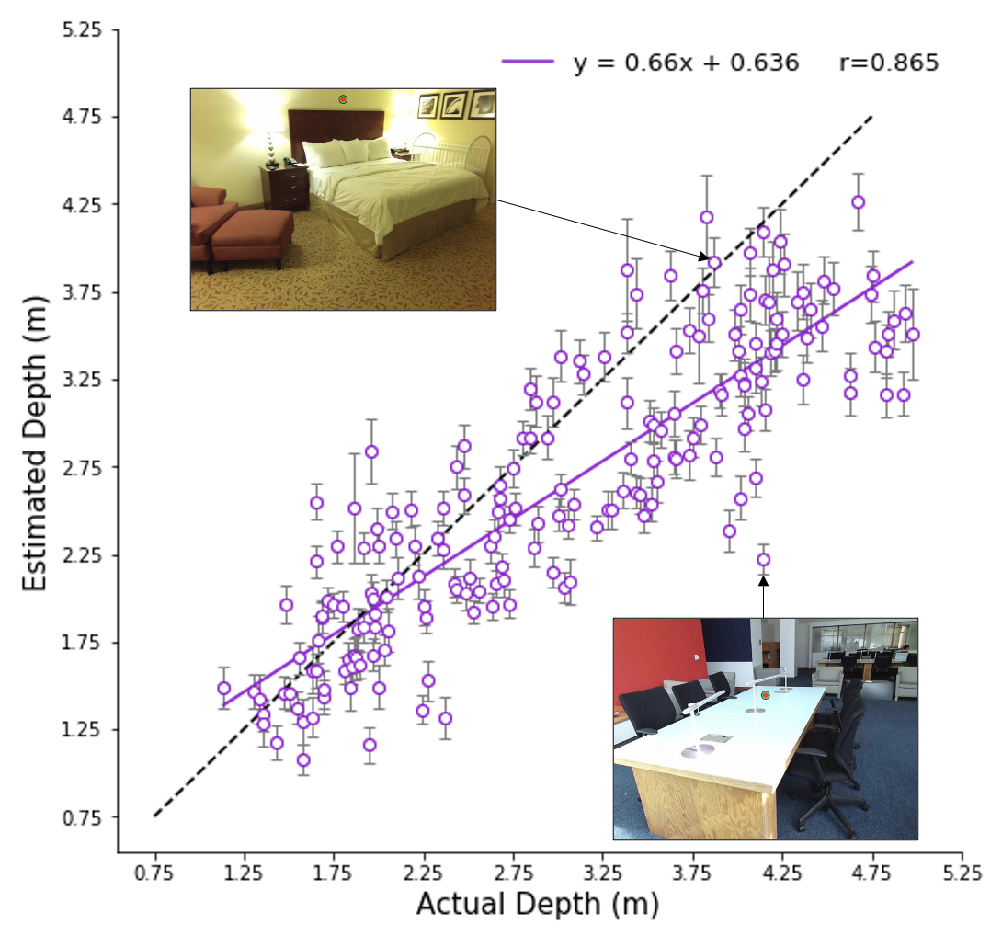
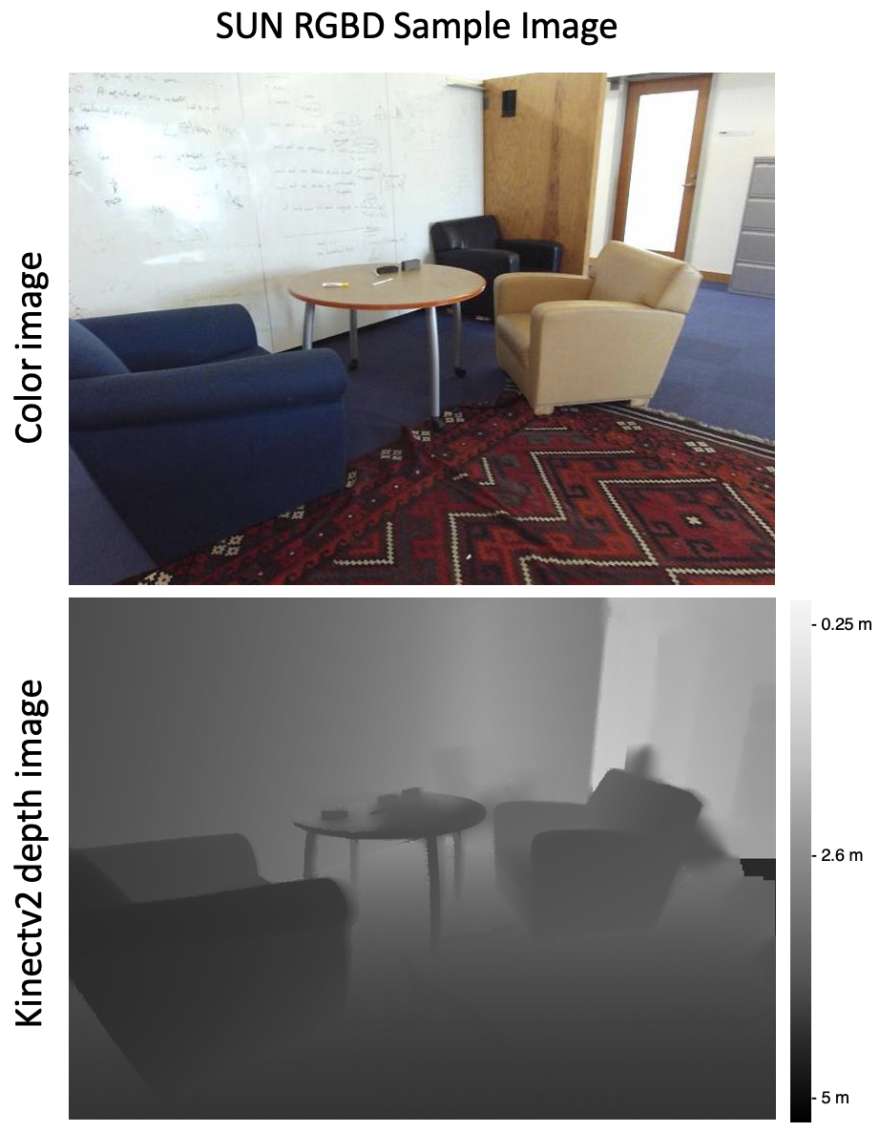
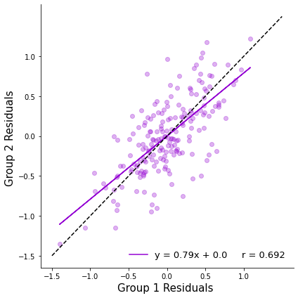
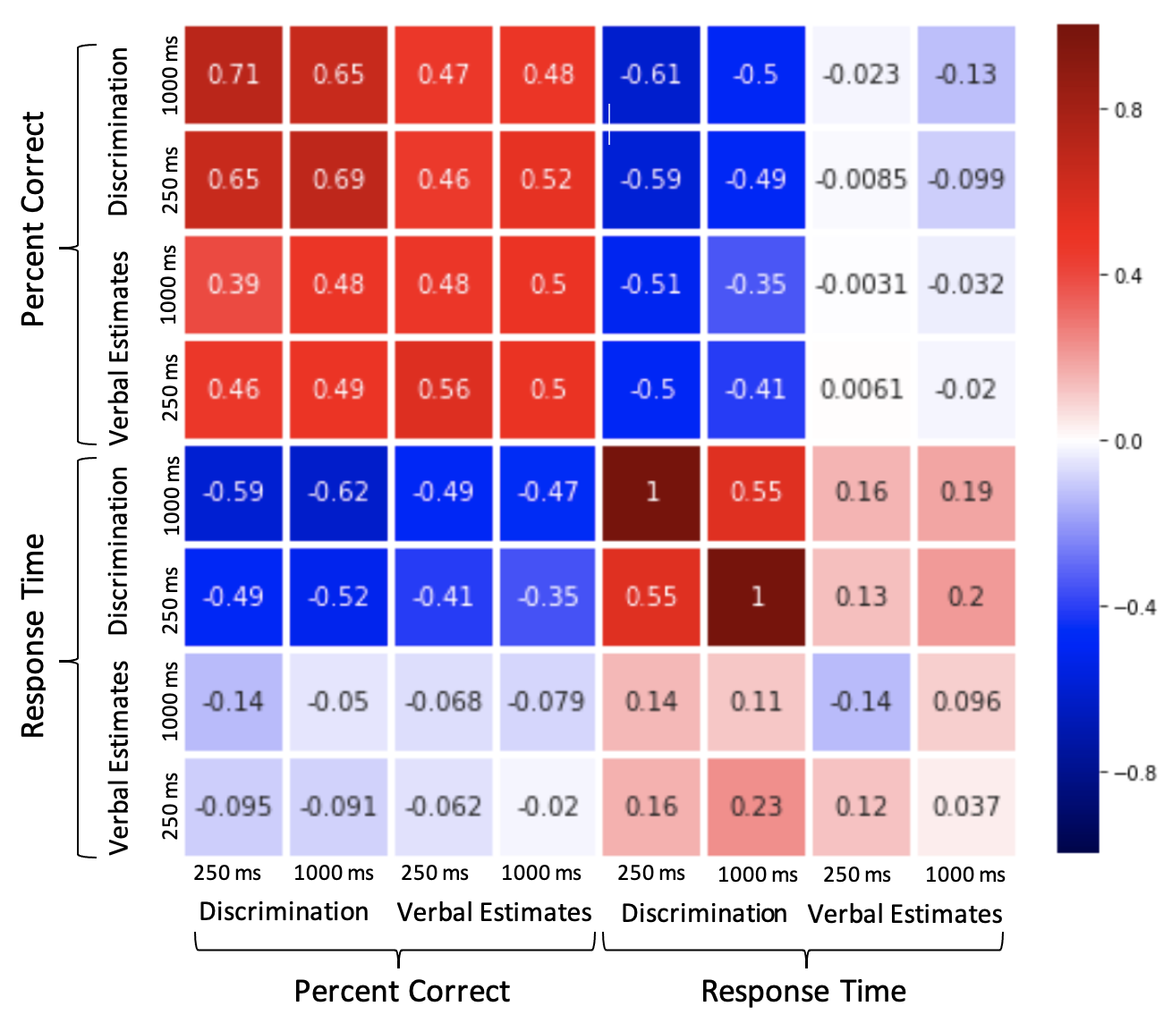
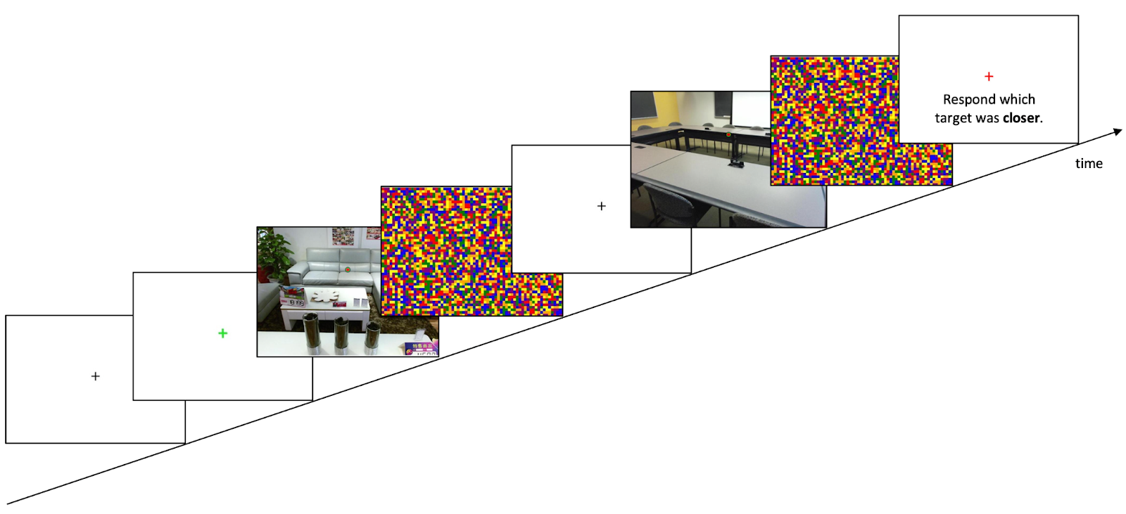
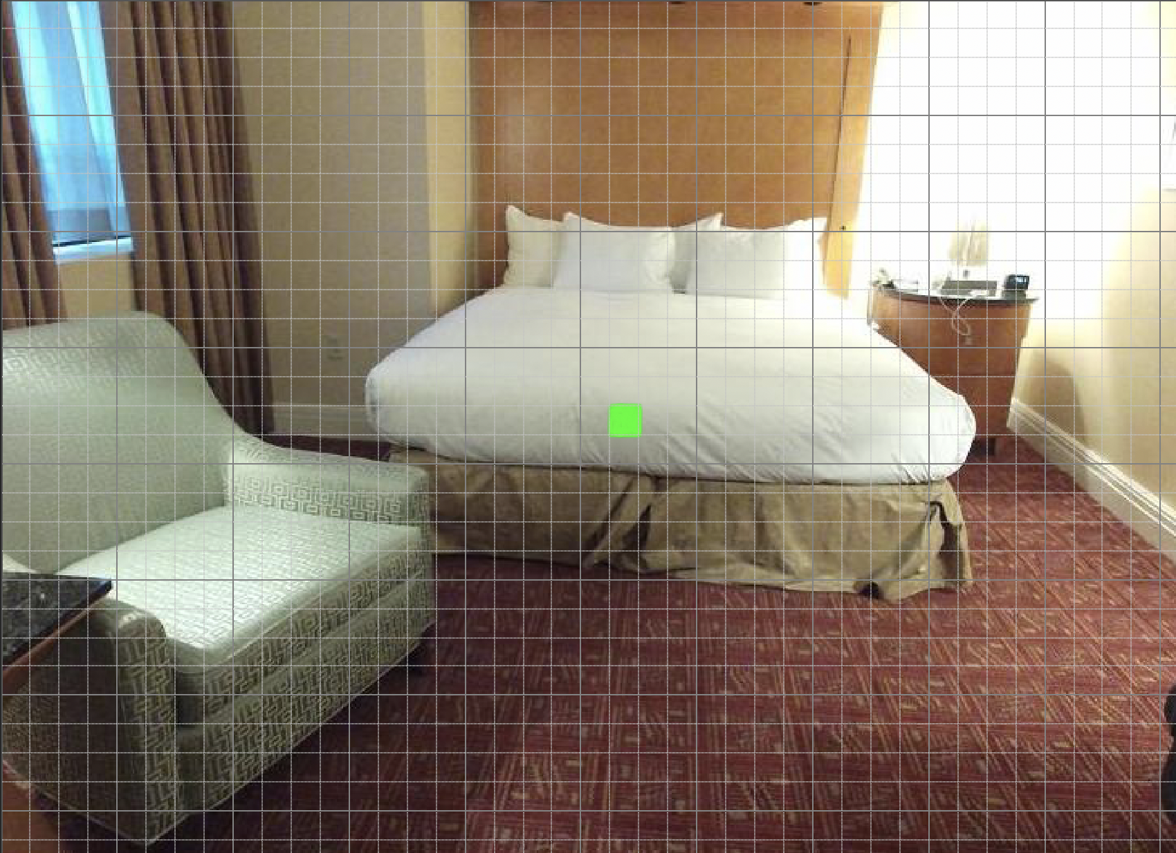
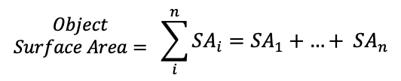
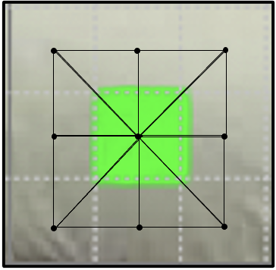
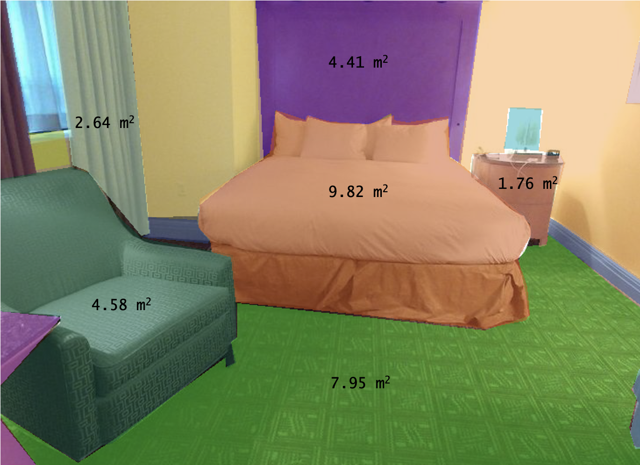
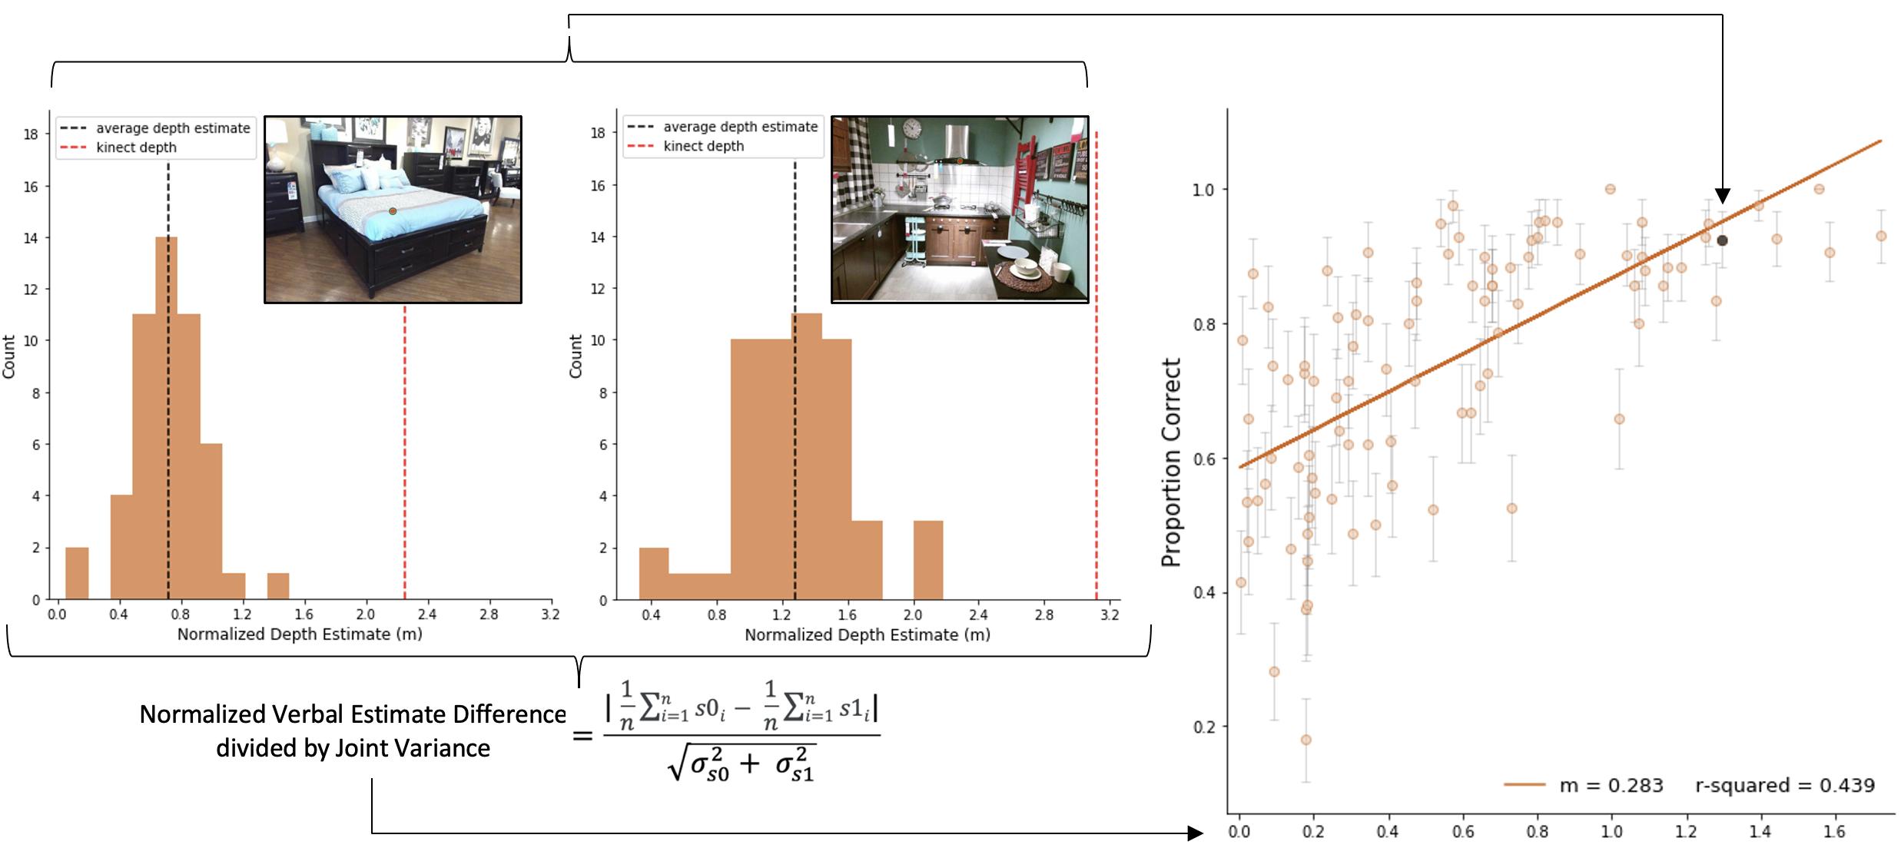
A Novel Generalization between Verbal Judgments and
Perceptual Discrimination of 3D Space
Prachi Mahableshwarkar, John Philbeck, and Dwight Kravitz
Department of Psychological and Brain Sciences, The George Washington University
Introduction
Based on prior work in this field, we hypothesize that human visual distance perception in pictured scenes optimally integrates visual distance cues with temporal processing differences.
Crowd-sourced data collection is leveraged to understand spatial perception within pictured scenes.
We use two matched tasks focusing on depth perception (discrimination, verbal report) and quantify their shared variance across a large set of images
PARADIGM: Participants viewed 192 images with targets at variable distances (1m – 5m) and made egocentric distance estimations (Fig 3).
RESULTS
Distance estimates to individual scenes showed increasing sensitivity to distance with longer viewing durations (F = 15.32, p < 10^-9) (Fig 4A, B).
Participants underestimate distance, but there is strong systematicity in responses
Stimuli
N = 192, Amazon Mechanical Turk
When the effect of the actual distance was regressed out, significant and consistent residuals for each scene replicated across durations (R2 ~ .56, p ~ 10^-35), despite no participant overlap (Fig 5A, B).
All images in the dataset were taken with the Kinectv2 sensors, so the “ground truth” distance of each target was extracted from the depth array for each image in the SUN-RGBD dataset (Fig 1).
All scenes are indoor and of diverse categories
PARADIGM: Participants report which image’s target was closer to them if they were to imagine themselves in the scene. There are 78 trials with images from the same stimulus set as Exp 1.
What spatial cues facilitate depth perception in pictured scenes (e.g., ground plane, familiar size, clutter)?
RESULTS
Discrimination performance was strongly predicted by signal detection analyses applied to the verbal estimates from Experiment 1 for the stimuli in each discrimination (R2 = .57, p < 10^-14).
N = 192, Amazon Mechanical Turk
Fig X.
Fig X. Algorithmic quantification of size to determine the degree to which familiar size drives task-general spatial perception and the amount of it’s influence over time.
Conclusion
REFERENCES
The generalization across tasks and participants suggests a stable and strong relationship between verbal report and discrimination, allowing for the creation of an explicit model that relates stimulus-based visual cues and 3D picture perception.
Notes:
Despite lack of monocular cues →
Stimuli → show target embedded picture, and remove text (add citation)
Put paradigms below Stimuli section → remove text
One big analysis section → VE figs (have a line that shows significance between the two stacked)
Make residual 8x8 matrix
Do depth at 250 and depth for 1000 – plotted in the same way
Raw image → show thatit is that pixel → formulae needs to reference something in the images
Future direction → a better stimulus set with more images→ stimulus set is not perfect
Need to include cues in the introduction (humans can do this but HOW?, we want to stable quantification of thebehavior that w can try to predict with image deatures)
METHODS – 4 separate groups pf subjects
Matrix: have an inset (discrim vs VE accuracy)
MEG czichy, aude oliva → make a cascade that goes with the inset
Have one of the diagonals plotted as well (RT)
Include Kinect regression plot
Col2: link tasks together

